Slide 1
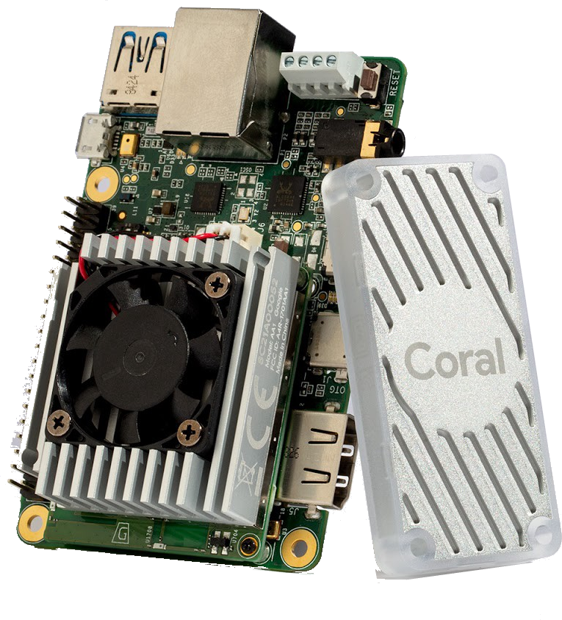
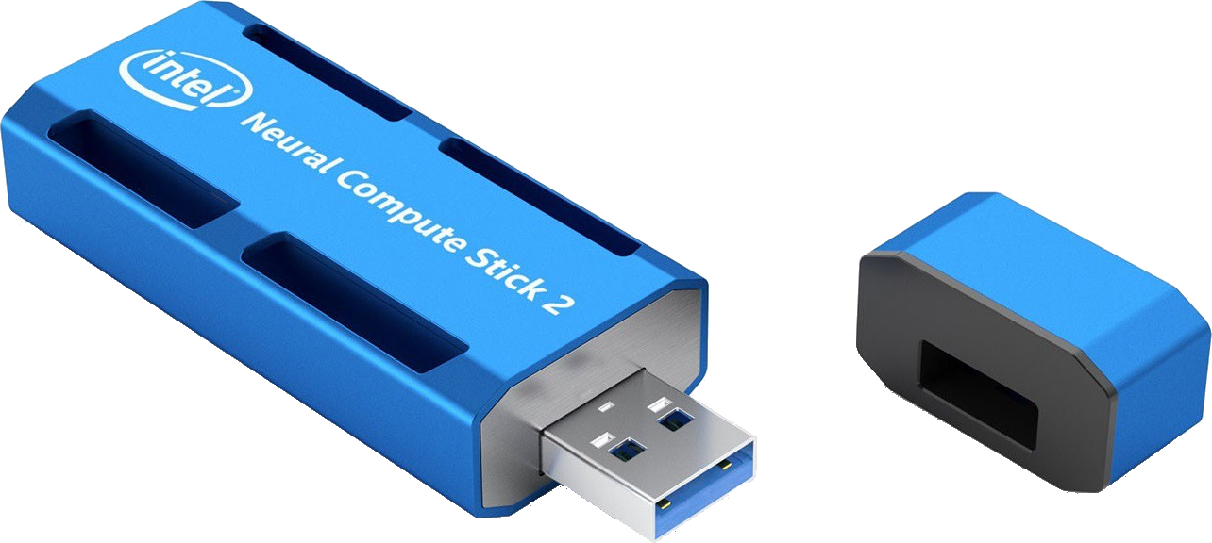
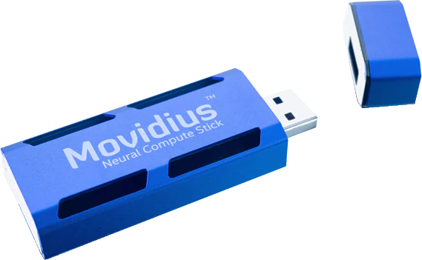
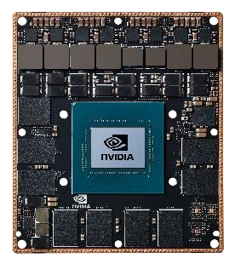
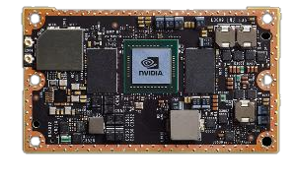
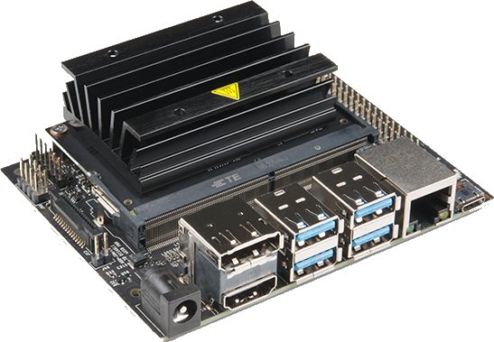
A Multiplicity of Edge/AIoT Solutions
Intel
Neural Compute Stick 2
(NCS2)
Google
Coral Dev Board & USB Accelerator
Intel
Neural Compute Stick
(NCS)
2017
2018
2019
nVidia
Jetson TX2
Dev Board
(1.3TFLOP@FP16)
nVidia
Jetson Nano
Dev Board
(0.5TFLOP@FP16)
nVidia
Jetson Xavier
Dev Board
(10TFLOP@FP16)

Slide 2

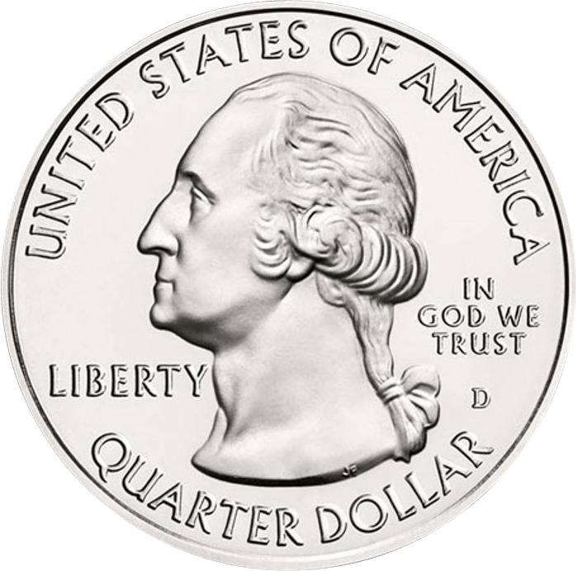
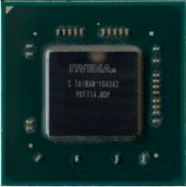
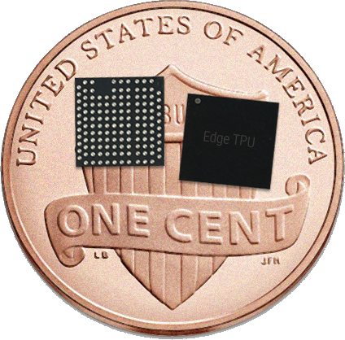
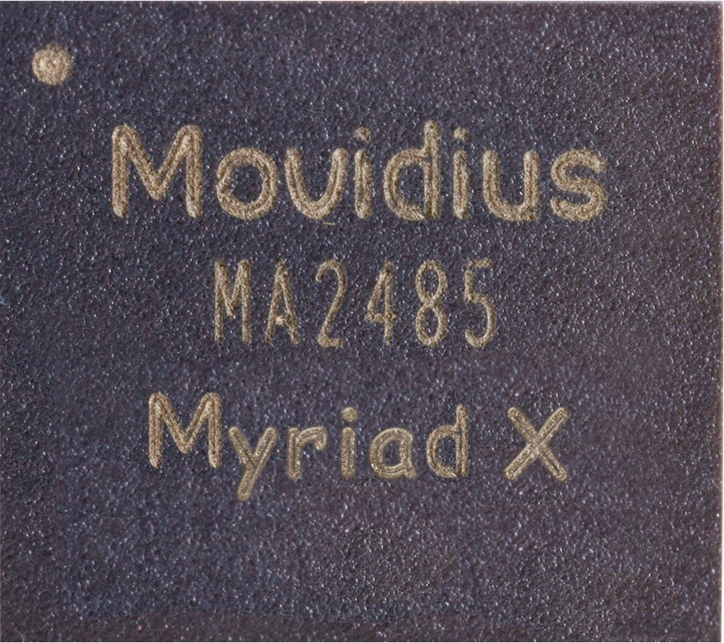
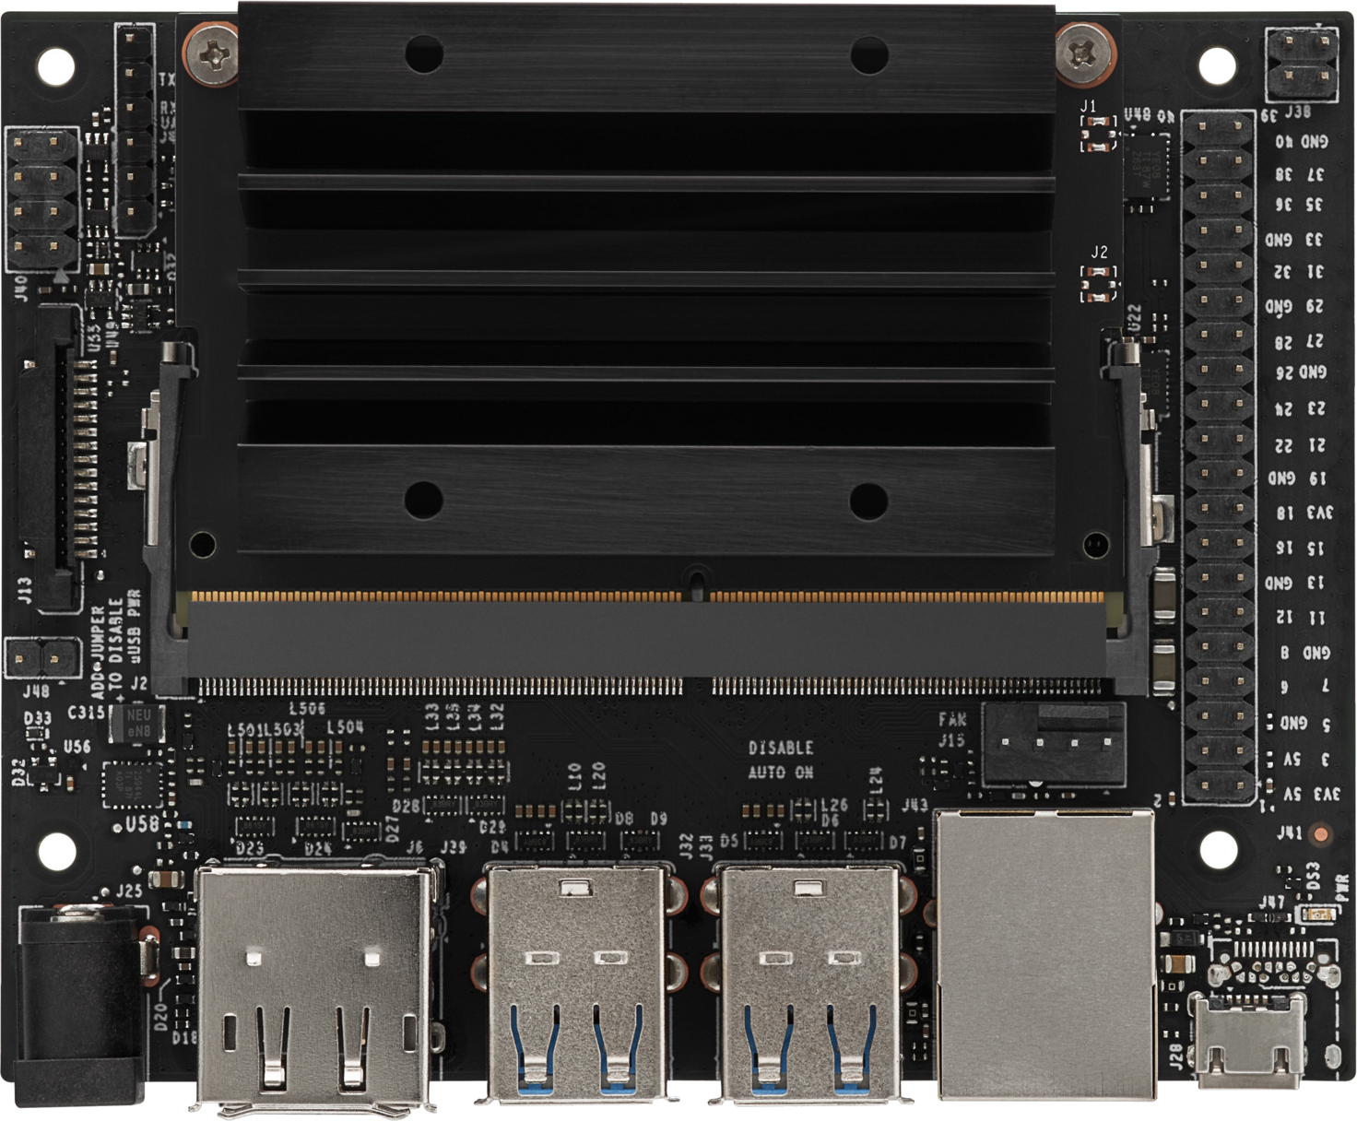
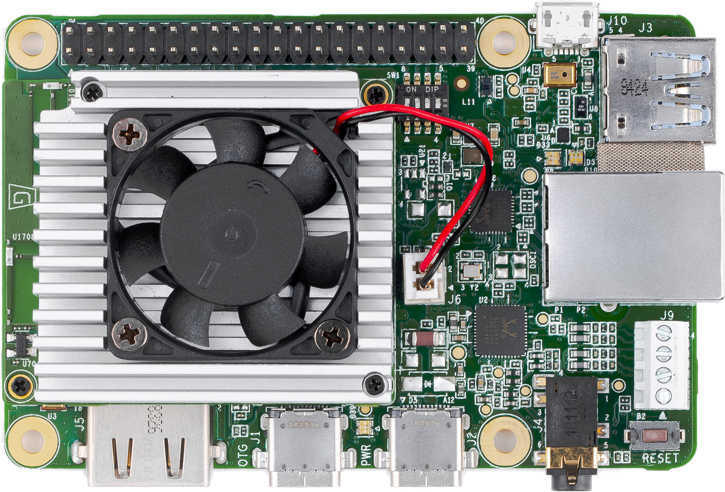
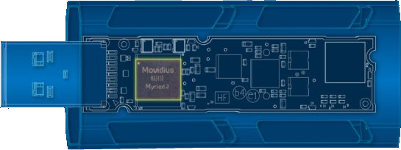
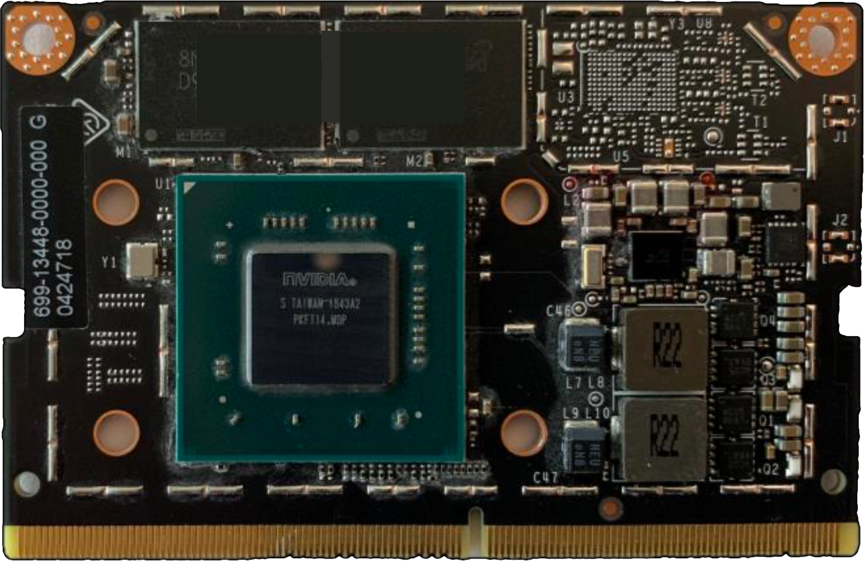
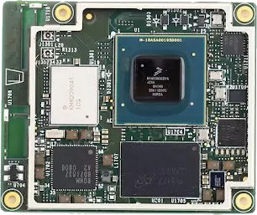
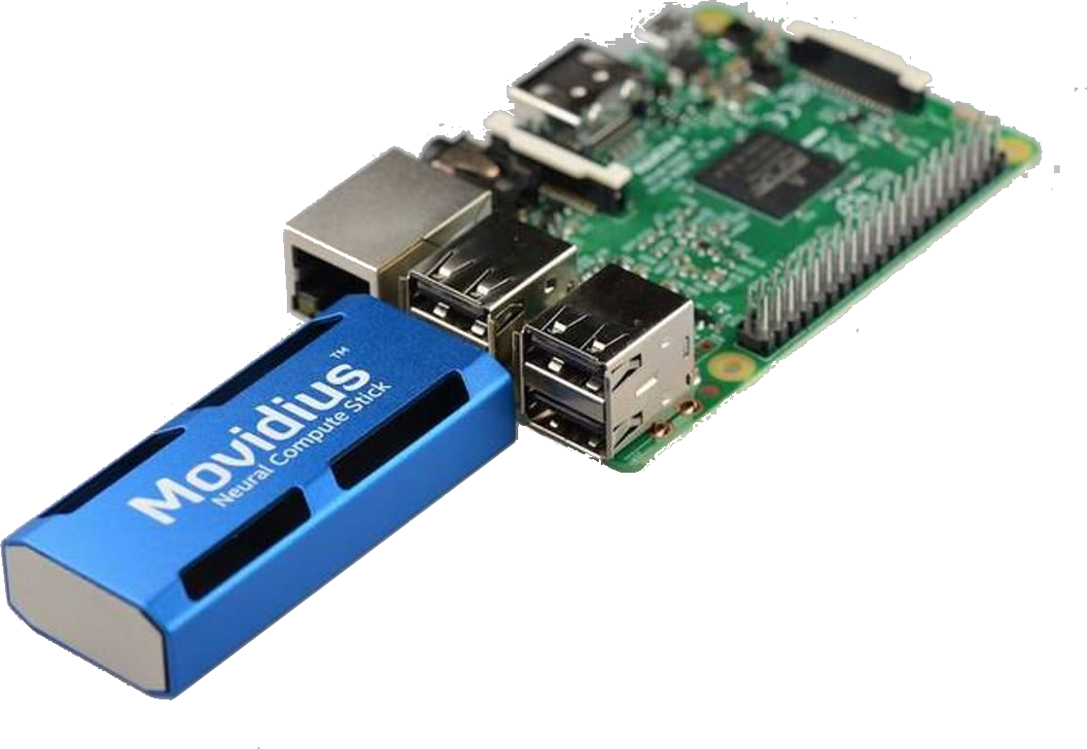
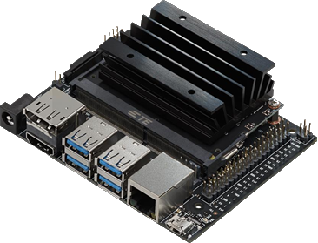
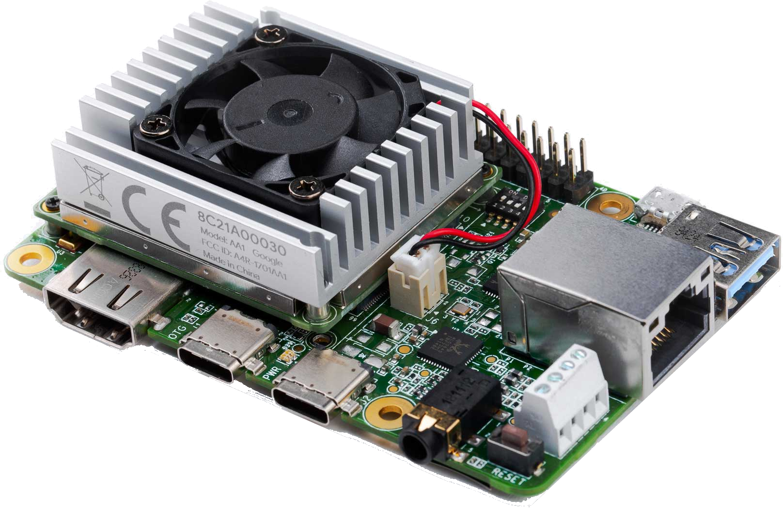
Inference Accelerator @ Edge
Intel
Myriad X
nVidia
Jetson Nano
Google
Edge TPU
NCS2 (US$99) +
Raspberry Pi
Jetson Nano Dev Board
(US$129)
Coral Dev Board
(US$150)

Slide 3
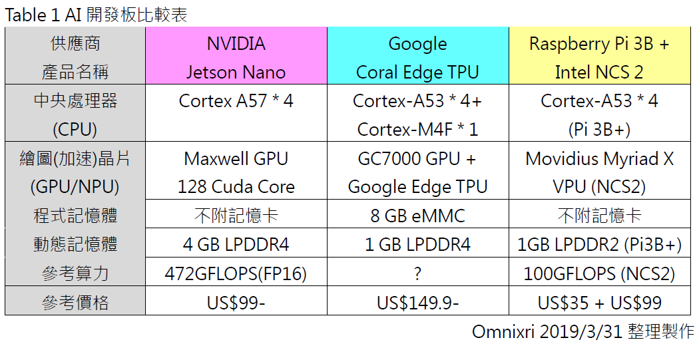

Slide 4
nV Jetson TX1 Nov/10’15 @CES’15, US$299, 1TFLOP (FP16)
nV Jetson TX2 Mar’17, US$399, 1.3TFLOP (FP16)
nV Jetson Xavier Aug’18, US$,1099, 11TFLOP (FP16)
nV Jetson Nano Mar 19 @nV GTC’19 San Jose, US$129 (US$99 Devkit), 0.5TFLOP
Intel NCS1 Movidius Myriad 2 VPU Jul’17 , US$79, 0.15TFLOP (FP16), 1TOPS (INT8)
Intel NCS2 Movidius Myriad X VPU Nov’18, US$99, 1TFLOPS (FP16), 4TOPS (INT8)
Google Edge TPU Dev Board, US$150, Jul’18, Coral Mar’19
Google Edge TPU USB, US$ 75, Jul’18, Coral Mar’19

Slide 6

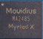

Slide 8
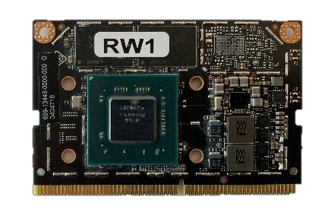
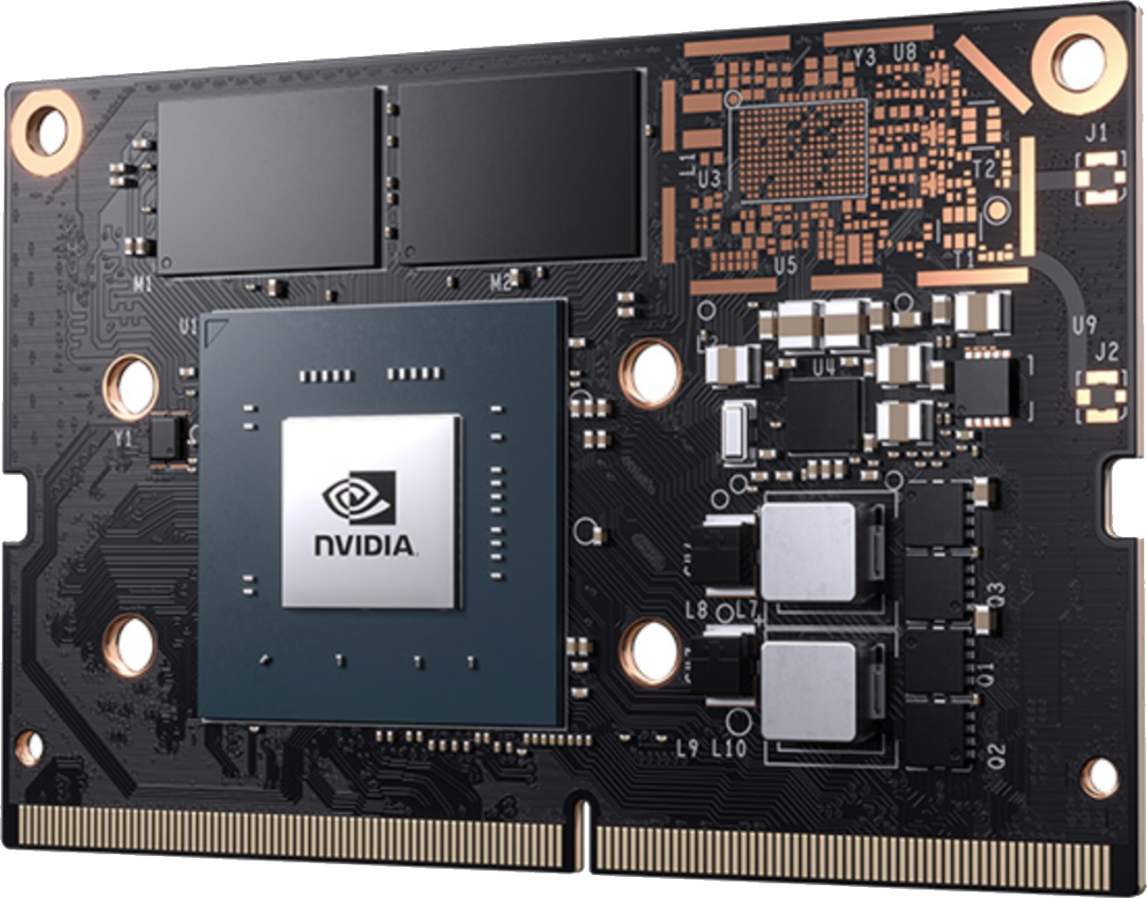
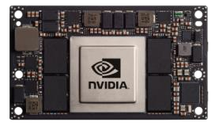
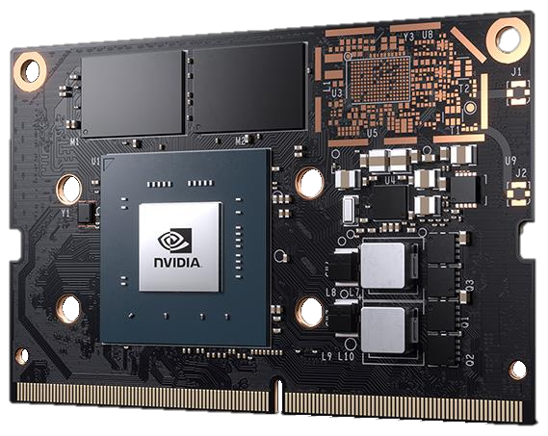

Slide 9




